Slide 1
LING529 – Final Project
By: Diego Alcantara

Slide 2
The Problem
Within OpenClass there are many questions across myriad topics that need to be tagged properly in order to effectively find gaps within students’ knowledge
OpenClass formed a competition to test the best topic matching algorithm
We were given 200 open linguistics questions that had been previously tagged as 1 or more topics as our training data

Slide 3
The Approach
What this ended up breaking down to was a multiclass, multilabel classification problem
Meaning we had several labels and each sample could be any of those labels
My initial plan was to use Keras as I had done a similar project in classifying tweets as any of several emotions
However, there were several differences between the two projects
The number of classes was 30 times larger in this project (10 in the tweets project vs >300 in this project)
I had significantly less data in this project (>2000 tweets vs 200 questions)
Input size was significantly larger in this project (~200 tokens in tweets vs > 16000 tokens in questions)

Slide 4
Keras Didn’t Work
The large input size and number of classes led to a huge memory cost
I could not train the model on my local machine as I would run out of memory before the training even started.
I tried using GoogleColab to run it and it crashed that notebook too
Google upgraded me to 25GB of memory, which was enough to train it
It still didn’t learn anything
F2 score of 0.05

Slide 5
Approach 2
I started from scratch and implemented my system using a very simple Logistic Regression classifier and a simple TFIDVectorizer for my input representation
Trying to using one classifier did just as poorly as the Keras implementation
Macro F2 score: 0.03
This was likely due to the structure of the input being incredibly sparse
Classifier
 | class_1 | class_2 | class_3 | … | … | … | class_325
sample_1 | 0 | 0 | 1 |  |  |  | 1
sample_2 | 1 | 0 | 0 |  |  |  | 1
Sample_3 | 0 | 1 | 0 |  |  |  | 0

Slide 6
Approach 2.1
Dr. Hahn-Powell advised me to create a classifier for each class
This resulted in 325 classifiers that learned to discriminate between those samples that were in that class vs those that were not
Then stitch the results back together into one matrix
This approach worked well resulting in a Macro F2 score of .16
 | classifier_1 | classifier_2 | classiferi_3 | … | … | … | classifier_325
 | class_1 | class_2 | class_3 | … | … | … | class_325
sample_1 | 0 | 0 | 1 |  |  |  | 1
sample_2 | 1 | 0 | 0 |  |  |  | 1
Sample_3 | 0 | 1 | 0 |  |  |  | 0

Slide 7
Refinements
I tried training only on parts of the input

Slide 8
More Refinements
Tried with combinations of the input

Slide 9
Even More
Tried different weighting for the “on” indicator (i.e. 1 for a sample means it belongs to that class)
Ended up picking a class weight of 177

Slide 10
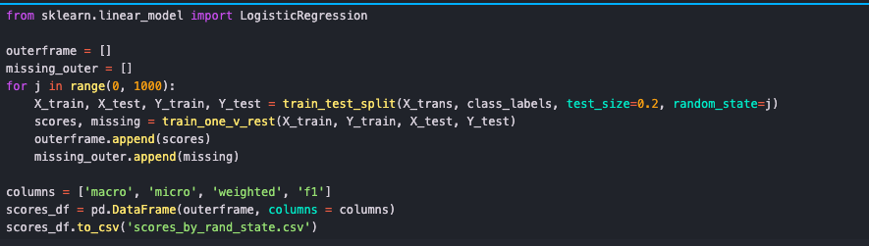

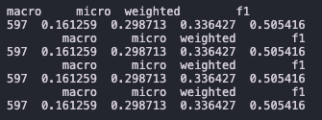
The True Benefit
F2 Score: 0.52

Slide 11
The WinningEst System
Leaderboard Team Name:
“I guess this’ll work”
The winning system ended up being a combination of several things
Using Approach 2.1 (1 classifier per class)
Using all parts of the input data
Using a class weight of 150
Class weight of 170 yielded similar results with tradeoff in precision and recall
Using all the provided training data to train
Resulted in an F2 score of .54 on the testing set

